Slide 1
Research Papers
AN IMPROVED ROUND ROBIN CPU SCHEDULING ALGORITHM(IRR)

Slide 2
IRR
The improved Round Robin (IRR) CPU scheduling algorithm works similar to Round Robin (RR) with a small improvement. IRR picks the first process from the ready queue and allocate the CPU to it for a time interval of up to 1 time quantum.
After completion of process’s time quantum, it checks the remaining CPU burst time of the currently running process. If the remaining CPU burst time of the currently running process is less than 1 time quantum, the CPU again allocated to the currently running process for remaining CPU burst time.

Slide 3
Otherwise, if the remaining CPU burst time of the currently running process is longer than 1 time quantum, the process will be put at the tail of the ready queue. The CPU scheduler will then select the next process in the ready queue.

Slide 4
Algorithm
Step 1. START
Step 2. Make a ready queue of the Processes say REQUEST.
Step 3. Do steps 4, 5 and 6 WHILE queue REQUEST becomes empty.
Step 4. Pick the first process from the ready queue and allocate the CPU to it for a time interval of up to 1 time quantum.
Step 5. If the remaining CPU burst time of the currently running process is less than 1 time quantum then allocate CPU again to the currently running process for remaining CPU burst time. After completion of execution, removed it from the ready queue and go to step 3.
Step 6. Remove the currently running process from the ready queue REQUEST and put it at the tail of the ready queue.
Step 7. END

Slide 5
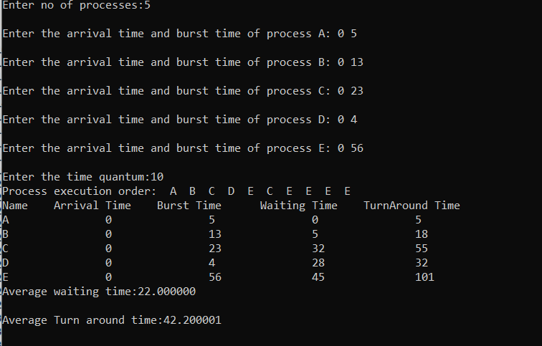
IRR

Slide 6
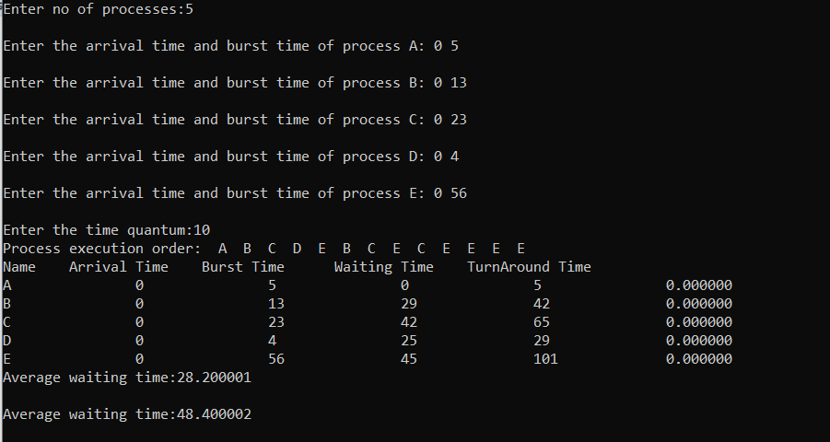
RR

Slide 7
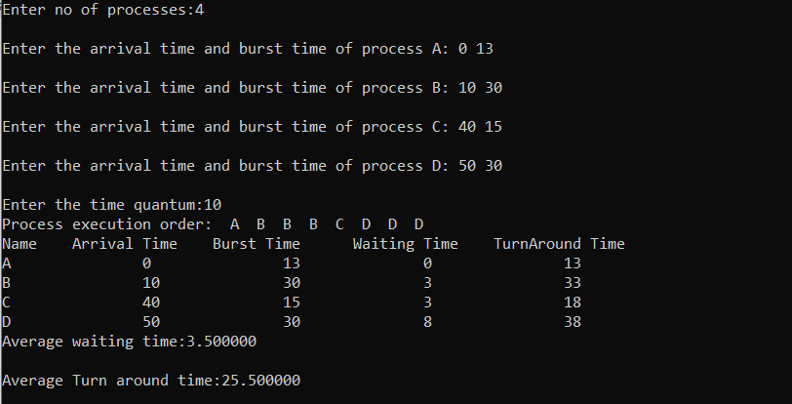
IRR

Slide 8
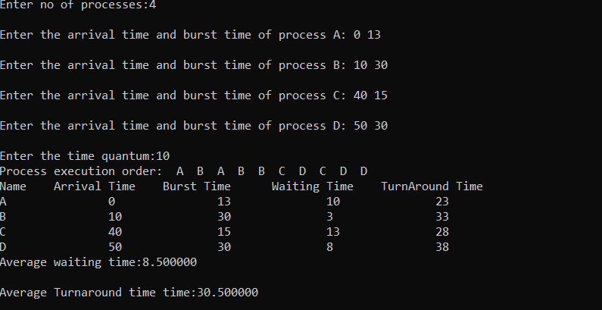
RR

